Slide 1




GoodCabs : Transportation & Mobility
Gunjan Revar

Slide 2
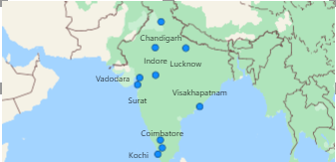
Problem Statement
GoodCabs is a cab service provider catering to tier-2 cities, dedicated to delivering a efficient transportation experience. The company emphasizes strong partnerships with local drivers while ensuring outstanding service for passengers.
With operations spanning 10 tier-2 cities, GoodCabs is driven by a passion for achieving ambitious goals and continuously exploring opportunities to enhance its services and customer satisfaction.

Slide 3
Objectives
Enhance Operational Transparency: Deliver a clear picture of daily business activities.
Track Performance Indicators: Measure critical metrics such as revenue, customer engagement, and ratings.
Facilitate Strategic Decisions: Empower stakeholders with data-driven insights for informed decision-making.
Identify Patterns and Outliers: Uncover trends and irregularity to drive business improvements.

Slide 4
Project Overview
The GoodCabs Project involves creating a Power BI Dashboard to analyze and visualize operational, financial, and customer-related data for GoodCabs. This project aims to provide insights into the following areas:
City Performance
Monthly Analysis
Target Performance
Insights

Slide 5
Dataset Overview
The dataset contain 8 CSV files & 2 databases containing record of each trip. A list of key insights asked by stakeholders are primary analysis questions. We use SQL report for ad-hoc business questions. I added SQL-based business questions to the GitHub repository.
This project is done based on 6 month of cab service data.

Slide 6
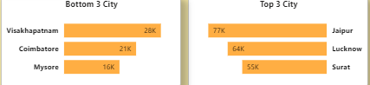
1. Top & Bottom Performing Cities
Identify the top 3 and bottom 3 cities by total trips over the entire analysis period.
Surat, Jaipur & Lucknow are top performing cities while Mysore, Coimbatore, Visakhapatnam shows minimal activity in terms of passenger trips.

Slide 7
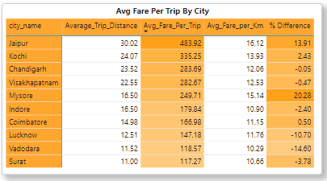
2. Average Fare Per Trip by City & compare it with the cities Average Trip Distance.
Average Trip Distance: Jaipur has the longest average trip distance, while Surat has the shortest .
Avg Fare Per Trip: Jaipur leads with the highest average fare per trip, and Surat has the lowest .
Avg Fare per Km: Mysore has the highest fare per km, while Vadodara charges the least .
% Difference: Jaipur's fare deviates most positively, whereas Mysore shows the largest negative deviation.

Slide 8
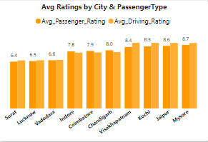
3. Average Passenger & Driver Ratings By City
Kochi, Jaipur & Mysore have highest Avg passenger ratings & Driver Ratings.
Surat, Lucknow & Vadodara have lowest Avg passenger ratings & Driver Ratings.

Slide 9
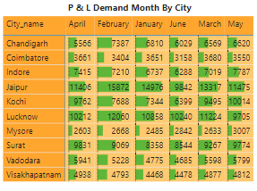
4. Peak & Low Demand Months by City
For each city, identify the month with the highest total trips and the month with the lowest total trips.
Jaipur peaks in February & March month & hit its low in January.
Coimbatore and Visakhapatnam show lower passenger counts compare to other cities.
June shows low count in most cities, indicating a seasonal low. February and March are high demand months.

Slide 10
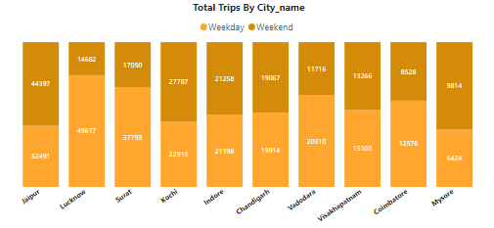
5. Weekend vs. Weekday Trip Demand by City
Weekday trips are highest in Lucknow, followed by Jaipur & Surat.
Weekday trips are highest in Jaipur, Kochi & Indore.

Slide 11
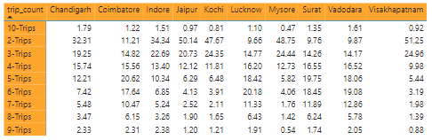
6. Repeat passenger frequency and City contribution Analysis
Kochi and Visakhapatnam have the highest repeat passengers for 2-Trips, showing strong loyalty from early repeat travelers.
In most cities like Chandigarh, Coimbatore, and Surat, the percentage of repeat passengers decreases as trip counts increase.
Cities like Mysore and Jaipur have a steady percentage of repeat passengers across trip counts, showing better customer retention.

Slide 12
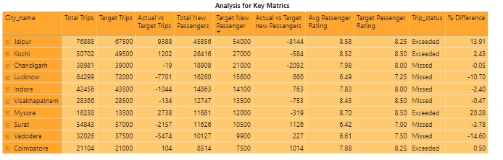
7. Monthly Target Achievement Analysis for Key Metrics
Jaipur leads with a significant positive variance of 13.91% in trip targets, indicating strong performance.
Lucknow and Surat faced notable shortfalls in trips, with deficits of -10.7% and -3.78%, respectively, requiring attention to improve efficiency.
Coimbatore exceeded both trip and passenger targets but only marginally (0.5%), showing steady growth potential.
Passenger satisfaction is high overall, but Lucknow's low average rating of 6.49 needs improvement to enhance service quality.

Slide 13
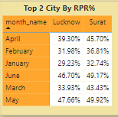
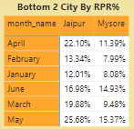
8.1 Highest & Lowest Repeat Passenger Rate by City & Month
Surat & Lucknow lead in RPR% among Business-focused cities.
Jaipur & Mysore have lowest RPR% among Tourism-focused cities.

Slide 14
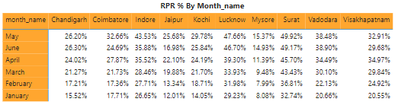
8.2 Highest & Lowest Repeat Passenger Rate by City & Month
Surat consistently leads with the highest Repeat Passenger Rate (RPR), peaking at 49.92% in May, indicating strong customer loyalty.
Mysore struggles with the lowest RPR across all months, particularly in May (15.37%) and January (8.08%), signaling a need to improve retention strategies.
Jaipur shows significant fluctuations, with its RPR starting low in January (12.01%) but improving by May (25.68%), reflecting gradual retention progress.
Lucknow and Vadodara exhibit steady growth, with Lucknow’s RPR consistently above 30% and Vadodara reaching a high of 38.90% in June.

Slide 15
Further analysis & Recommendations
Factors Influencing Repeat Passenger Rates: Key factors include service quality, pricing, city demographics, and lifestyle patterns. Cities with better service and competitive pricing are likely to see higher repeat passenger rates.
Tourism-Focused Cities:
Customize the travel experience for tourists.
Provide guide assistance services, especially during peak seasons.
Incorporate cultural elements into the service during local festivals.
Business-Focused Cities:
Establish exclusive partnerships with conference venues and hotels.
Offer subscription-based or discounted ride packages for businesses to support employee transportation.
Use traffic data integration to streamline and optimize routes.

Slide 16
Emerging Mobility Trends: Electric vehicle adoption and green initiatives are shaping tier-2 city cab markets. Goodcabs should consider integrating EVs and eco-friendly policies to stay competitive and appeal to environmentally conscious customers.
Partnership Opportunities with Local Businesses: Collaborating with hotels, malls, or event venues can boost demand and foster customer loyalty. These partnerships can drive more traffic, particularly in tourism-heavy or high-footfall areas.
Data Collection for Enhanced Decisions: Goodcabs should gather data on customer preferences, booking patterns, feedback, and operational metrics to refine strategies. Insights into market trends and behavior will enable tailored services and improved efficiency.

